Slide 1
RATINGS PREDICTION
Submitted by:
Bishwajit Bhattacharya

Slide 2
ACKNOWLEDGMENT
I taken the data from Flipkart, although the rating was in decimal value but to get proper output, I round up the data. As a result, the target value is integer.
Most of rating is 4 as because I got the data is mostly like 4.2,4.3,4.4 like this so after round up its coming 4.
From sk learn I got all the regressor model.

Slide 3
INTRODUCTION
Customer reviews are very important part of production. But the problem is how we will know product is likeable or not. By rating a product is median to be sure the product is good or bad.
Normally this rating is done out of 5 some times out of 10 also.
Product quality can be easily measured by this.

Slide 4
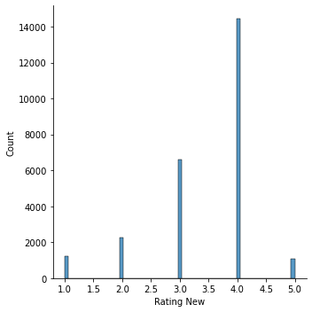
Visualizations

Slide 5
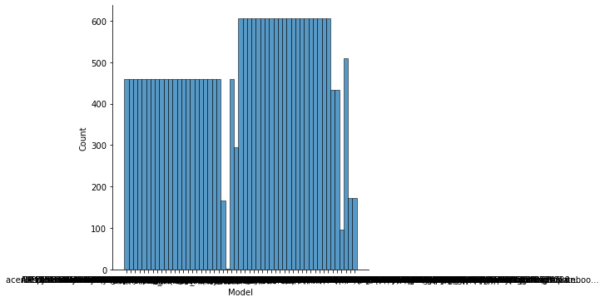
Model count

Slide 6
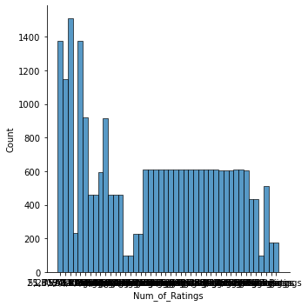
Num_of_Rating

Slide 7
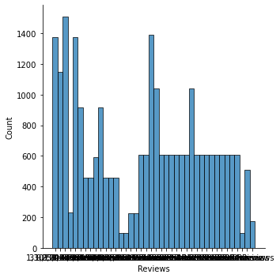
Review

Slide 8
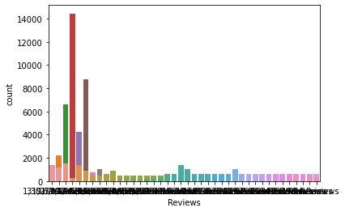
Reiview

Slide 9
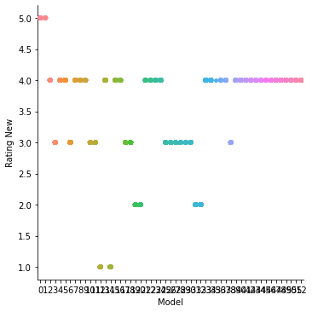
Model Vs Rating using catplot

Slide 10
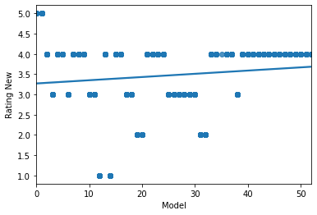
Model Vs Rating using RegPlot

Slide 11
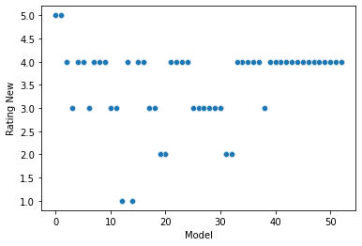
Model Vs Rating using scatterplot

Slide 12
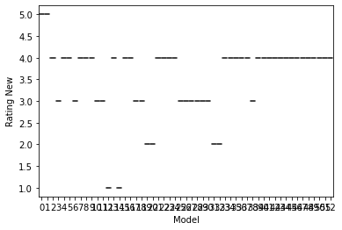
Model Vs Rating on Box Plot

Slide 13
Conclusion on Model Vs Rating all the plot
Highest no of data came for rating 4
Second highest data for 3
Third highest data for 2
1 and 5 is similar and list no of data.

Slide 14
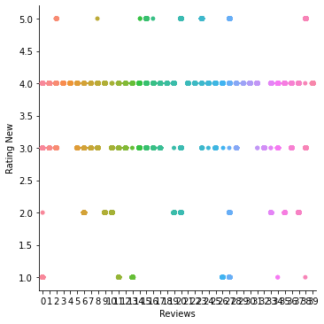
Review vs Rating Cat plot

Slide 15
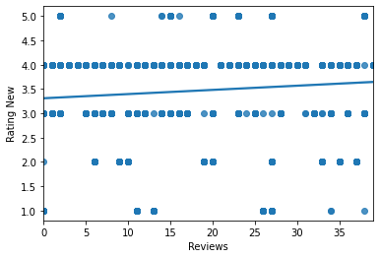
Reviews vs Rating Regplot

Slide 16
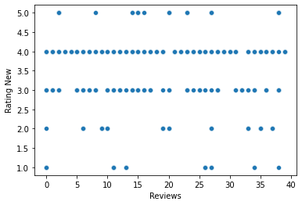
Review Vs Rating scatterPlot

Slide 17
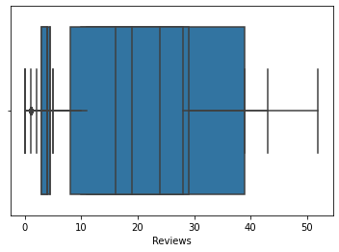
Review box plot

Slide 18
Conclusion on all the plots
Highest review is 30-35000 and it rating is for this is 4
Many of the product has less than 1000 review also.
Review vs rating showing highest no of rating covers on 4.
Second highest rating is 3
Third highest is 2
Lowest is 1 and 5.

Slide 19
Limitations of this work and Scope for Future Work
As per the requirement I adjust the decimal value, so if I did not do that might be results little differ.
No all the customer rate the product so it does not mean data is exactly correct.
I think if we got proper rating from, we can improve this.

Slide 20
Thank You
Bishwajit Bhattacharya

